Slide 1
Tcl as my daily tool
Arjen Markus
EutoTcl 2015

Slide 2
Just some background
In 2011 I got the opportunity to do a 4-year project: “Nanoparticles in water”
Back to my roots – water quality modelling
It should result in my getting my PhD
It has been 3.5 years now …

Slide 3
What do I do?
Gather measurement data:
  Published by the Bundesanstalt für Gewässerkunde for instance
  From institutes themselves or via the Internet
Analyse these data – basic statistics
Set up numerical models
Result: a large bunch of ad-hocish Tcl programs

Slide 4

So: what am I looking for?
Engineered nanoparticles?
Nanoparticles in consumer products
How much enters the (aquatic) environment?
Behaviour in water – aggregation, sedimentation, dissolution

Slide 5
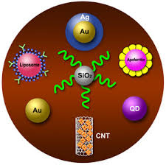
Engineered nanoparticles?
Definition (roughly): particles with a size of 1 to 100 nm
Made of various materials: SiO2, TiO2, ZnO, CeO2, Ag, Au, C, CdSe, …
Carbon nanoparticles:
  Fullerenes – C60, with or
    without functional groups
  Carbon nanotubes – fibers
Properties?
  Strengthen materials
  Antimicrobial
  Photokatalytic, …
Problems? Plenty

Slide 6
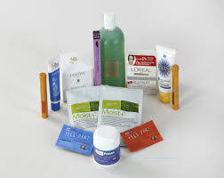
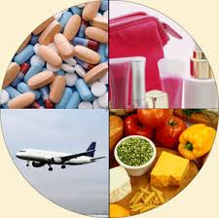
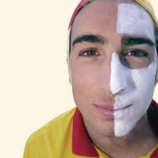
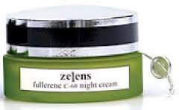

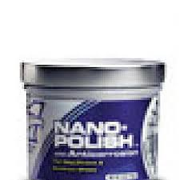


Nanoparticles in consumer products

Slide 7
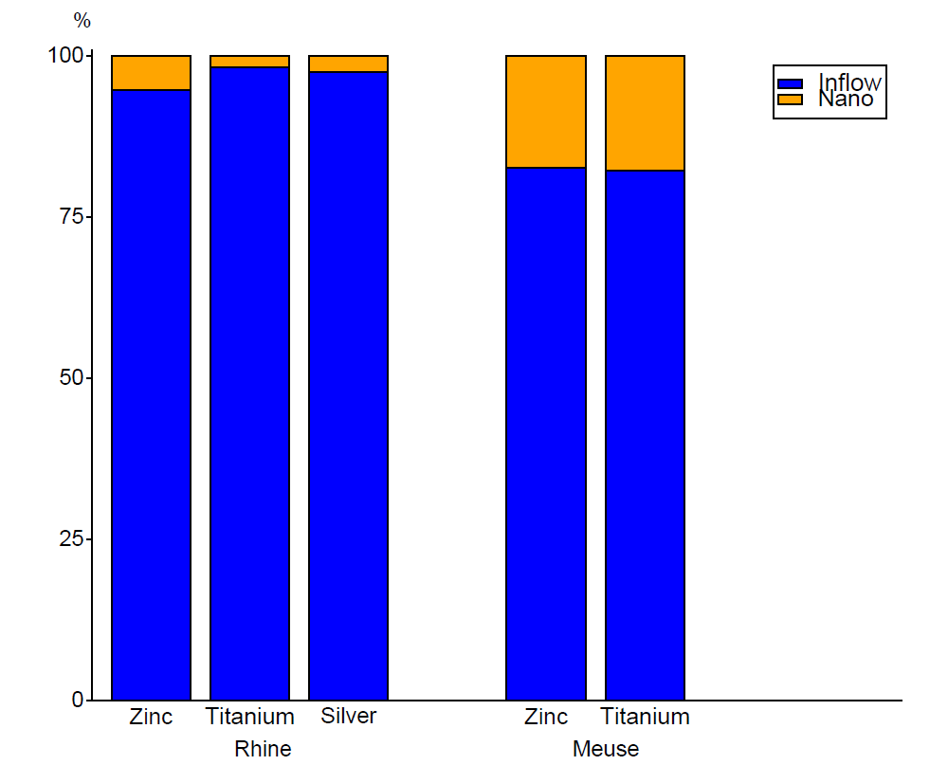
How much enters the (aquatic) environment?
Problems:
  Measurement techniques are still under development
  Hardly any data from industry
Solution: Estimate and model:
  Measurements of total
  concentration → load
  Estimated use of nanomaterials
  → load
Data:
Typical use of consumer products
Population in the two river basins
Ignored: influence WWTPs

Slide 8
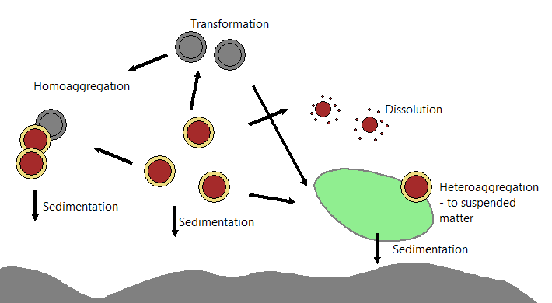
Behaviour in water – aggregation, sedimentation, dissolution

Slide 9
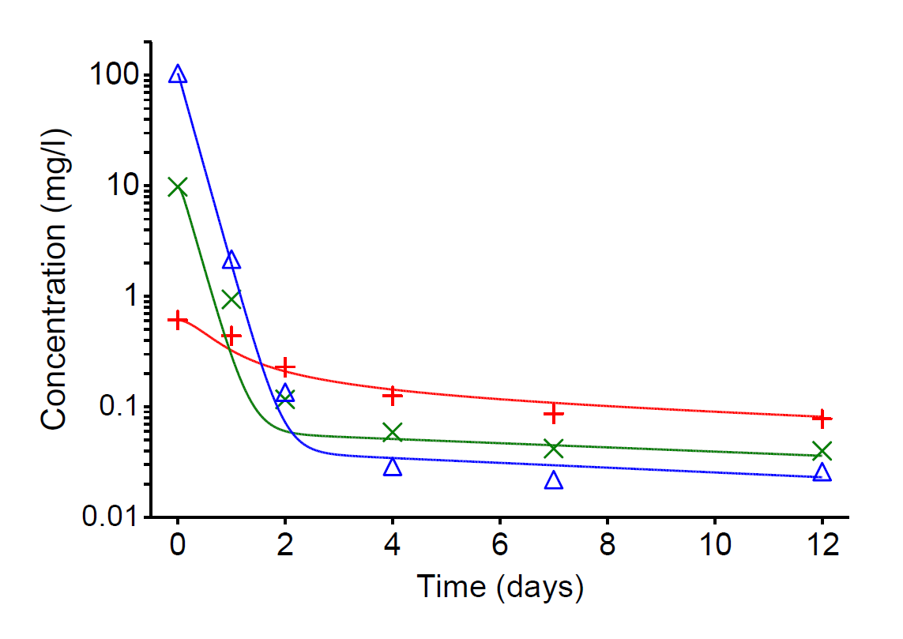
Behaviour – captured in a mathematical model
Based on laboratory experiments
Symbols: measured concentrations
Lines: model result

Slide 10
Basic data analysis and statistics
My data files:
LOBITH;RHEIN;S;Algemene parameters;Zwevend stof in mg/l;E14;2006;1;04.01.2006;;15
LOBITH;RHEIN;S;Algemene parameters;Zwevend stof in mg/l;E14;2006;2;18.01.2006;;22
LOBITH;RHEIN;S;Algemene parameters;Zwevend stof in mg/l;E14;2006;3;01.02.2006;;16
LOBITH;RHEIN;S;Algemene parameters;Zwevend stof in mg/l;E14;2006;4;15.02.2006;;20
LOBITH;RHEIN;S;Algemene parameters;Zwevend stof in mg/l;E14;2006;5;01.03.2006;;44
Or:
"Lobith ponton“ "Zwevende stof in mg/l in oppervlaktewater“ "2000-01-16“ "12:00“ "“ "15.0“ "“ …
"Lobith ponton“ "Zwevende stof in mg/l in oppervlaktewater“ "2000-01-17“ "12:00“ "“ "15.0“ "“ …
"Lobith ponton“ "Zwevende stof in mg/l in oppervlaktewater“ "2000-01-18“ "12:00“ "“ "16.0“ "“ …
"Lobith ponton“ "Zwevende stof in mg/l in oppervlaktewater“ "2000-01-19“ "12:00“ "“ "24.0“ "“ …
"Lobith ponton“ "Zwevende stof in mg/l in oppervlaktewater“ "2000-01-20“ "12:00“ "“ "22.0“ "“ …

Slide 11
Basic data analysis and statistics (2)
Every institute uses (slightly) different formats, though often CSV-based
while { [gets $infile1 line] >= 0 } {
set pieces [split $line \;]
set station [lindex $pieces 0]
set dmy [split [lindex $pieces 8] .]
set date "[lindex $dmy 2]-[lindex $dmy 1]-[lindex $dmy 0]"
set value [string map {, .} [lindex $pieces end]]
if { $station in $selected && [lindex $dmy 2] == "2007" } {
$p plot $station $date $value
}
}

Slide 12
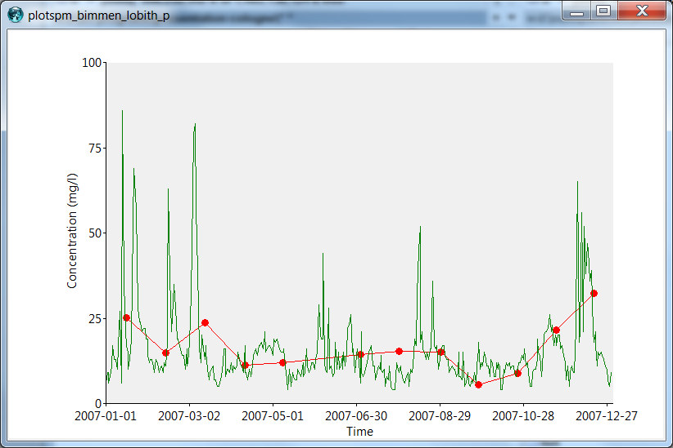
The result …

Slide 13
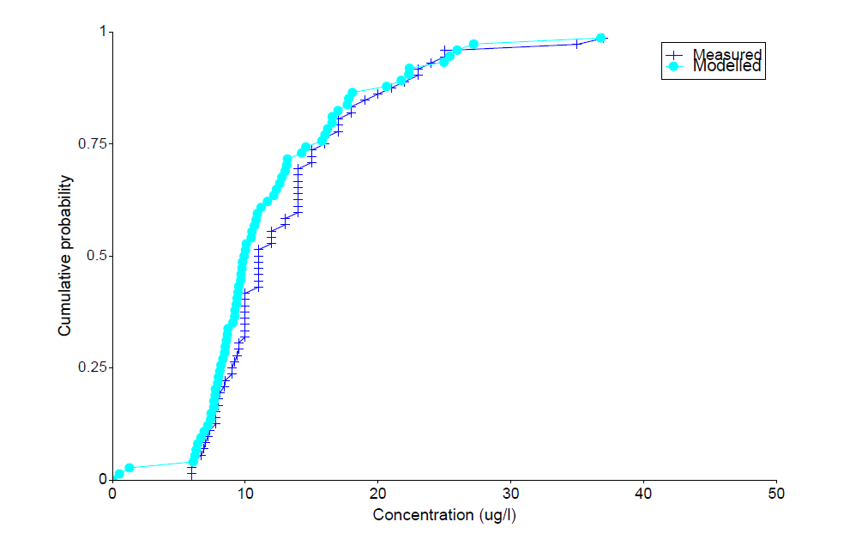
A statistical plot
Cumulative distribution

Slide 14
Numerical models
For me they are mostly solving differential equations
(and others …)

Slide 15
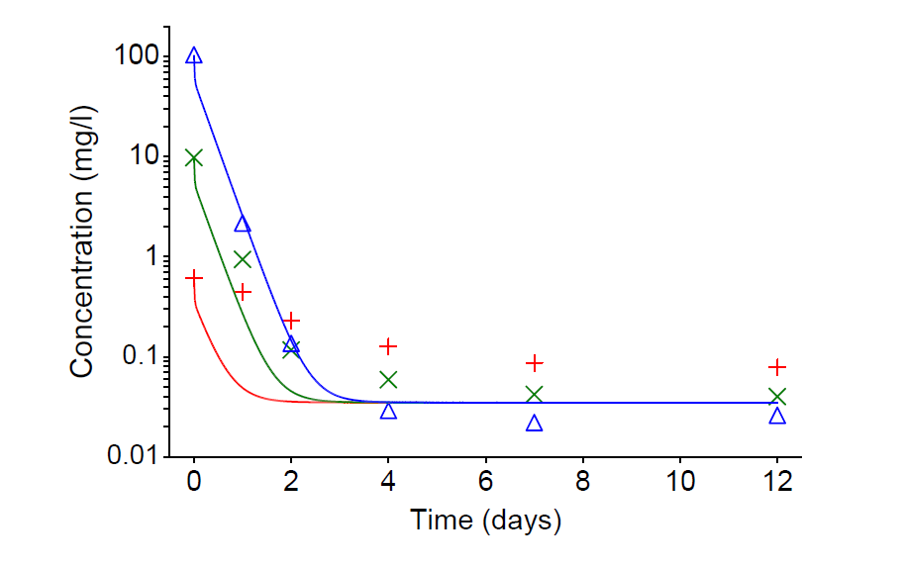
The result
Comparison of model results and measurements

Slide 16
Writing articles
I prefer to use Latex – let Latex worry about the layout
The pictures in my articles are just (PDF) files on disk. Replace the file and regenerate the document
A life saver: the pdf4tcl package
set pdf1 [::pdf4tcl::new %AUTO% -paper {9.5c 6.0c}]
$pdf1 canvas .c -width 9.2c
$pdf1 write -file daily-vs-twoweekly-spm.pdf

Slide 17
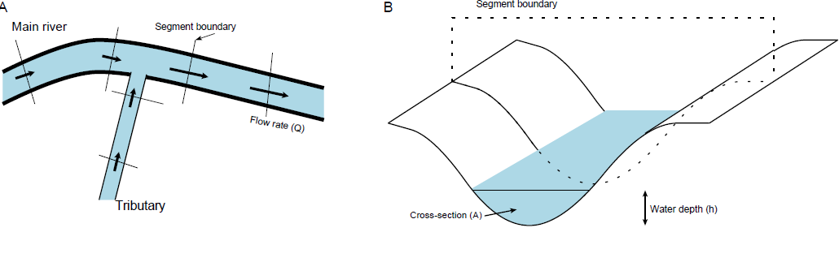
Writing articles (2)
Drawing on a computer is not my cup of tea
So I program my sketches – in Tcl

Slide 18
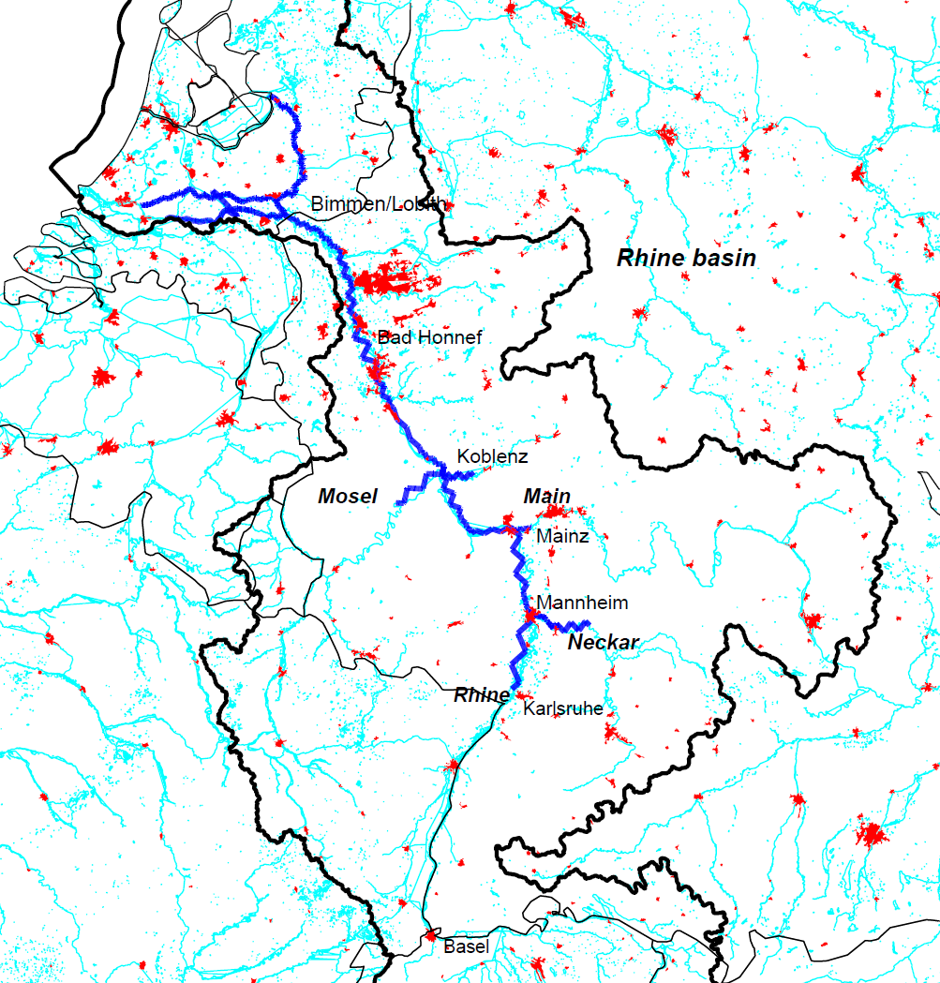
Writing articles (3)
But what about geographical maps?
Simple: use
shape files

Slide 19
All part of the job: course material
In march I participated in a course for researchers: determination, characterisation and modelling of nanomaterials
So I set down and came up with a number of exercises for them
Tcl is just the tool for that job ;)

Slide 20
Time for a small demo

Slide 21
And to round off: a movie
Results of my model for the Rhine
The frames were produced using Tcl (PDF files)
Then use ImageMagick to convert these PDF files into GIF and finally into an animated GIF
The program took a few hours to create the end result – but computers are patient

Slide 22
The movie

